Slide 1
Shopping Website
Rishabh Gupta (2002900100119/ CSE / 3CSB)
Nikhil saini (2002900100076 / CSE/ 3cSB)

Slide 2
Objective
The Amazon Script is one of the best well-known e-commerce sites which has been analyzed and developed by us to give the enlightened features for the users.
Trying to giving the functionalities like the real amazon website.

Slide 3
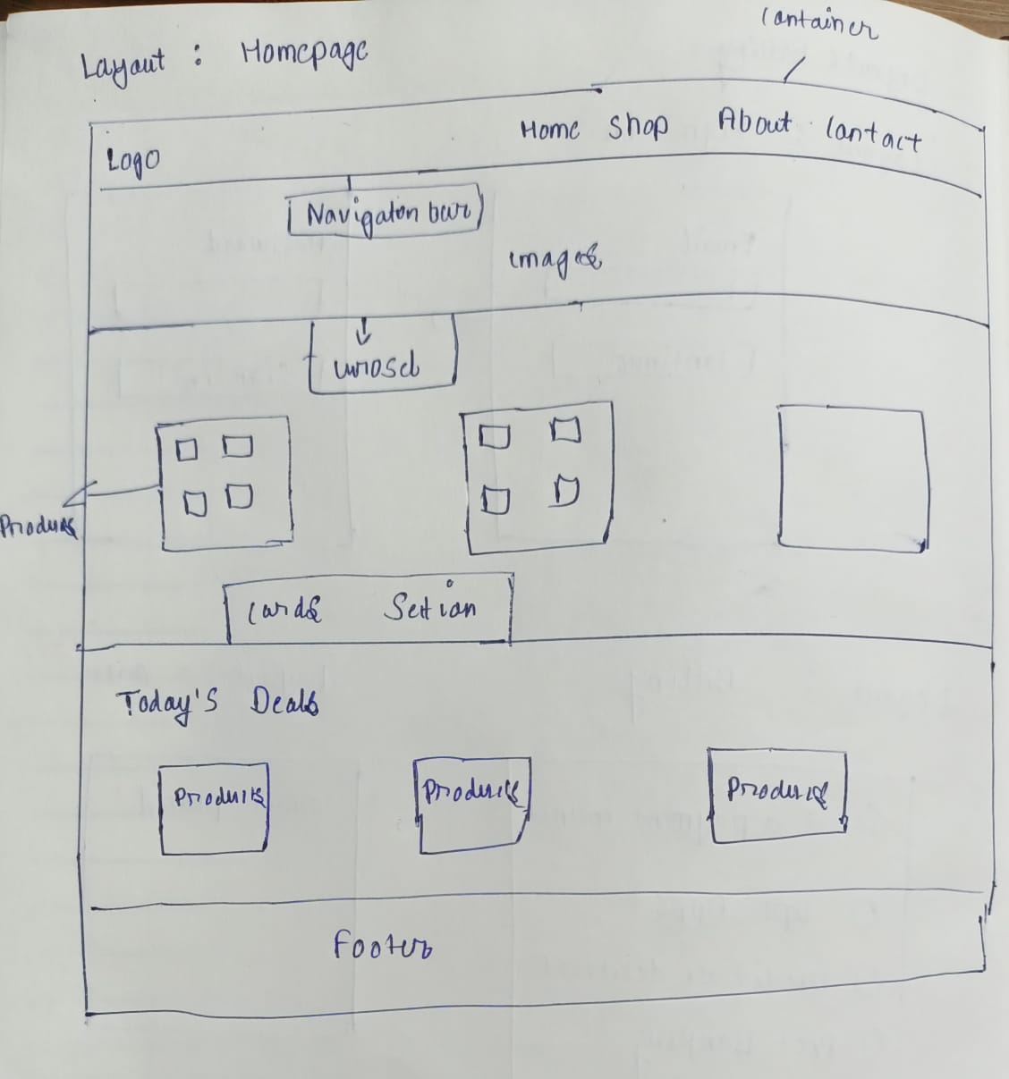
Layout

Slide 4
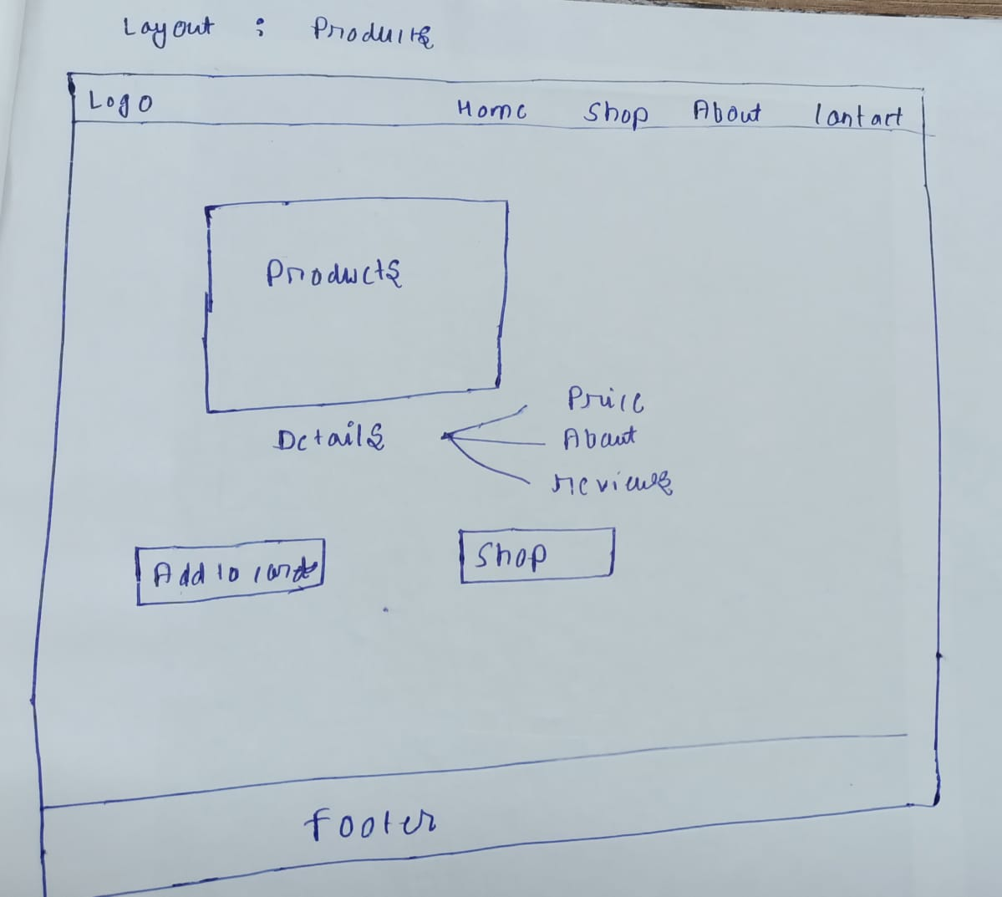
layout
Using bootstrap navbar for this layout

Slide 5
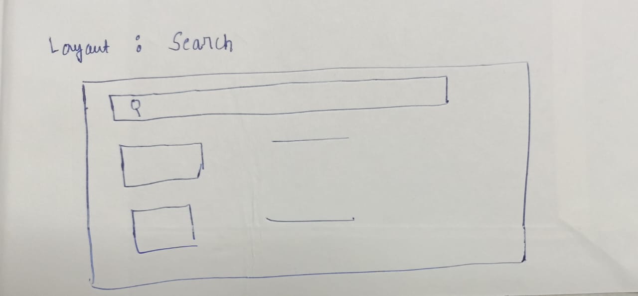
layout
For this Slider images , we use Carousel bootstrap feature
As we see Right and left button to move the images.

Slide 6
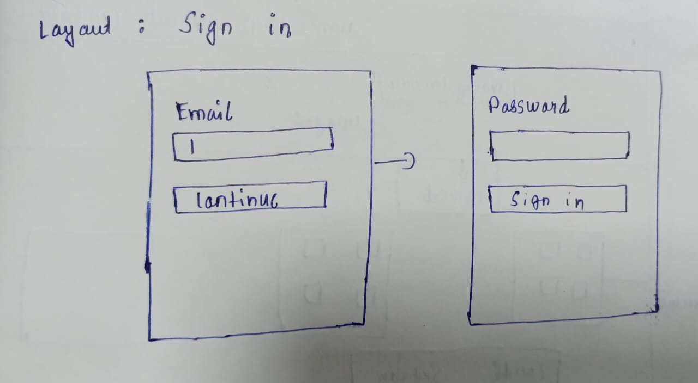
layout
We are going to use Cards from the bootstrap for this layout
Cards will be insert in the grid section.

Slide 7
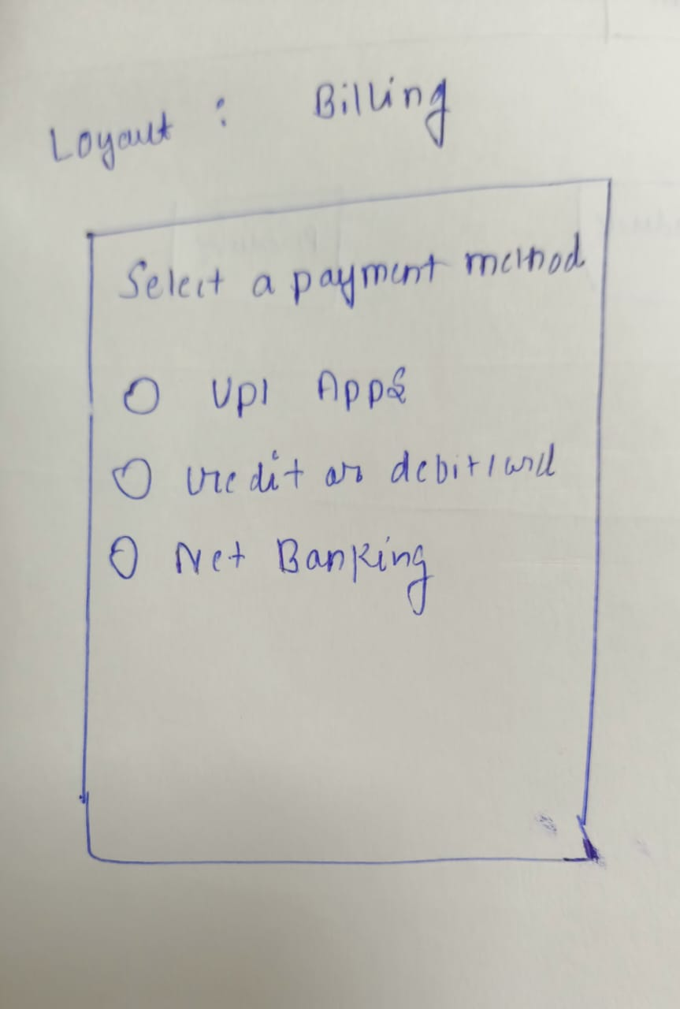
layout
Footer will be used in our website to give the footer by using bootstrap.

Slide 8
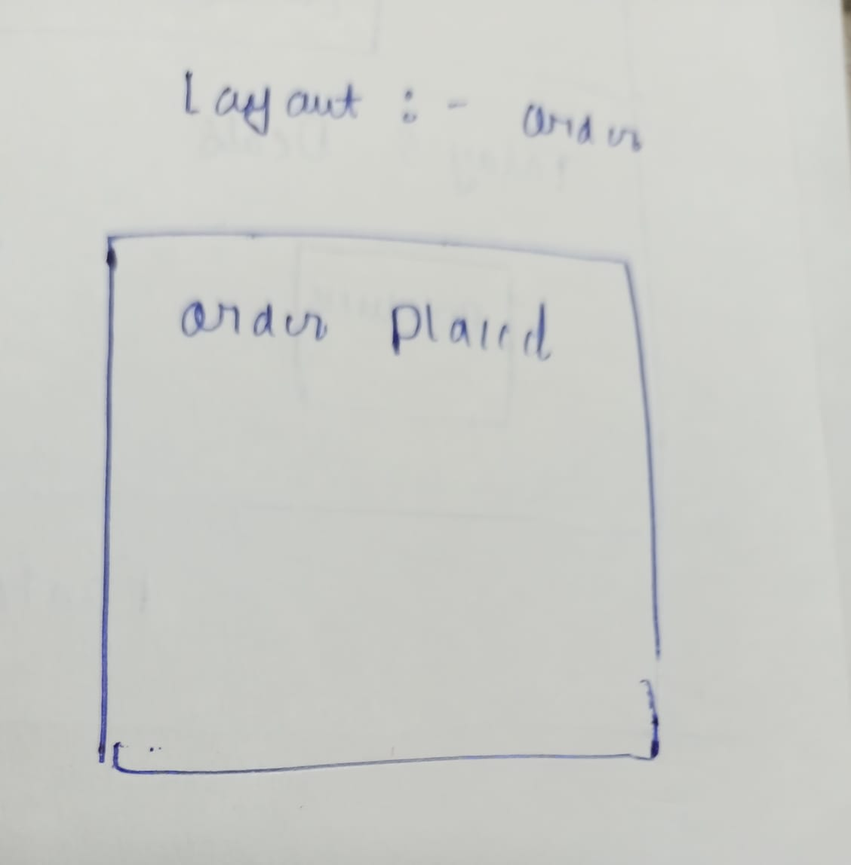
layout

Slide 9
Details about component
Nav bar:-
A navigation bar is a section of a graphical user interface intended to aid visitors in accessing information.
Navigation bars are implemented in operating systems, file browsers, web browsers, apps, web sites and other similar user interfaces.

Slide 10
Details about component
Carousel:-
The carousel is a slideshow for cycling through a series of content, built with CSS 3D transforms and a bit of JavaScript.
It works with a series of images, text, or custom markup. It also includes support for previous/next controls and indicators.

Slide 11
Details about component
Grids:-
uses a series of containers, rows, and columns to layout and align content.
Cards:-
A card is a flexible and extensible content container. It includes options for headers and footers, a wide variety of content, contextual background colors, and powerful display options.
Footer:-
A footer is an additional navigation method for websites. It can hold links, buttons, company info, copyrights, forms and many other elements.

Slide 12


